Slide 1


Slide 2




Slide 3



Basic I/O Operations In Java

Slide 4
INPUT / OUTPUT STREAMS

Slide 5
INPUT / OUTPUT STREAMS
Streams represent the flow of data and that data can be in any format
Like (byte, text, primitive data type, etc)
To write data into a destination, the output stream is used
To read the data, the input stream is used

Slide 6
DIFFERENT FORMATS OF READING AND WRITING
Types of data
Binary data
Text data
Formatted data
Buffering

Slide 7
INPUT / OUTPUT STREAMS
Binary data
Data will be read in byte format : 0’s and 1’s
“FileInputStream” and “FileOutputStream “classes are used for reading the content as a byte
In this way, for every byte, the compiler will send a request to the OS

Slide 8
INPUT / OUTPUT STREAMS
more test.txt This is a text file. It contains two lines. hexdump test.txt 0000000 54 68 69 73 20 69 73 20 61 20 74 65 78 74 20 66 0000010 69 6c 65 2e 0a 49 74 20 63 6f 6e 74 61 69 6e 73 0000020 20 74 77 6f 20 6c 69 6e 65 73 2e 0a 000002c
Notes:
Java programs can read or write binary data as a stream of raw bytes without any processing.
The lowest-level facilities for this are java.io.InputStream and java.io.OutputStream.
These provide basic mechanisms for reading and writing data one byte at a time or an array of several bytes at a time.
The classes InputStream and OutputStream are abstract classes, which means they cannot be instantiated directly.
One must instantiate them using one of their concrete implementations.
There are numerous options, depending on the source or destination of the data: AudioInputStream, ByteArrayInputStream, FileInputStream, ObjectInputStream, StringBufferInputStream, etc.
These classes are rarely used by themselves, but are usually wrapped in other classes that provide extra functionality, such as buffering or encoding/decoding. More on this below.
A binary file is one containing data that is not meant to be interpreted as text; for example, images or audio files.

Slide 9
INPUT / OUTPUT STREAMS
import java.io.File; import java.io.FileInputStream; import java.io.FileNotFoundException; import java.io.DataOutputStream; import java.io.FileOutputStream; import java.io.IOException; class Main { public static void main(String[] args) { File file = new File("read.bin"); FileOutputStream fos = null; DataOutputStream dos = null; try { fos = new FileOutputStream(file); dos = new DataOutputStream(fos); dos.writeInt(50244); dos.writeDouble(400.253); dos.writeChar('d'); dos.flush(); } | catch (IOException e) { e.printStackTrace(); } finally { try { if (fos != null) { fos.close(); } if (dos != null) { dos.close(); } } catch (Exception e) { e.printStackTrace(); } } } }

Slide 10
INPUT / OUTPUT STREAMS
Text data
Text data consists of Java strings or character streams
A string is a fixed finite sequence of characters and is an instance of java.lang.String
The DataInputStream or DataOutputStream, classes are used to read and write
The content as primitive data type such as boolean, char, byte, short, int, long, float, double and String

Slide 11
INPUT / OUTPUT STREAMS
import java.io.File; import java.io.FileInputStream; import java.io.FileNotFoundException; import java.io.DataOutputStream; import java.io.FileOutputStream; import java.io.IOException; public class Main { public static void main(String[] args) { File file = new File("read.bin"); FileOutputStream fos = null; DataOutputStream dos = null; try { fos = new | FileOutputStream(file); dos = new DataOutputStream(fos); dos.writeInt(50244); dos.writeDouble(400.253); dos.writeChar('d'); dos.flush(); }

Slide 12
INPUT / OUTPUT STREAMS
catch (IOException e) { e.printStackTrace(); } finally { try { if (fos != null) { fos.close(); } if (dos != null) { dos.close(); } } catch (Exception e) { e.printStackTrace(); } } } }

Slide 13
INPUT / OUTPUT STREAMS
import java.io.File; import java.io.DataOutputStream; import java.io.FileOutputStream; import java.io.IOException; public class Main { public static void main(String[] args) { File file = new File("read.bin"); FileOutputStream fos = null; DataOutputStream dos = null; try { fos = new FileOutputStream(file); dos = new | DataOutputStream(fos); dos.writeInt(50244); dos.writeDouble(400.253); dos.writeChar('d'); dos.flush(); } catch (IOException e) { e.printStackTrace(); } finally { try { if (fos != null) { fos.close(); }

Slide 14
INPUT / OUTPUT STREAMS
if (dos != null) { dos.close(); } } catch (Exception e) { e.printStackTrace(); } } } }

Slide 15
INPUT / OUTPUT STREAMS
Formatted data
To translate raw text or binary data to the desired form
This may involve specialized hardware, for example, to play an audio stream or to display an image
A highly versatile and configurable class for parsing input text in a known format is java.util.Scanner
On the output side, java.io.PrintStream provides extensive text formatting capabilities

Slide 16
INPUT / OUTPUT STREAMS
Buffering
Access to the underlying input stream may be inefficient if the source is remote or the medium is slow
To improve performance, input streams and readers are often wrapped in a BufferedInputStream or BufferedReader to provide buffering
InputStream in = new BufferedInputStream(new FileInputStream(fileName)); Reader in = new BufferedReader(new FileReader(fileName));

Slide 17
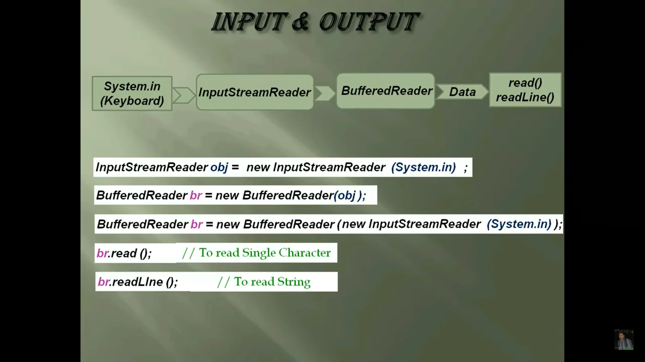

Slide 18
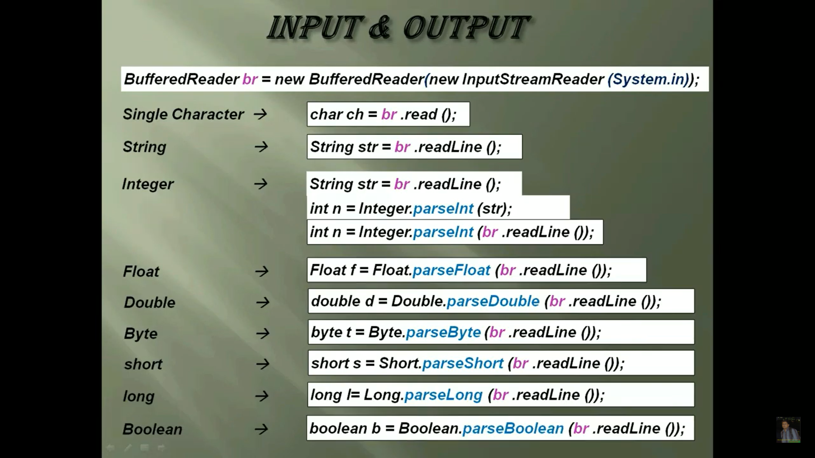

Slide 19
INPUT / OUTPUT STREAMS
import java.io.File; import java.io.BufferedReader; import java.io.BufferedWriter; import java.io.FileWriter; import java.io.FileReader; import java.io.IOException; public class Main { public static void main(String[] args) throws IOException { BufferedReader input = null; BufferedWriter output = null; try | { input = new BufferedReader(new FileReader("input.txt")); output = new BufferedWriter(new FileWriter("output.txt")); int c; while ((c = input.read()) != -1) { output.write(c); } }
Notes:
When you use the FileInputStream or FileReader classes, for every read or write operation, a new request will be sent to OS. So, this may lead to performance issue. In order to avoid this BufferedInputStream or BufferedReader, classes are used to wrap unbuffered classes.
This reads the input stream when the buffer is empty.
Likewise, FileOutputStream or FileWriter, classes are wrapped with BufferedOutputStream or BufferedWriter to write the output once the buffer is full.

Slide 20
INPUT / OUTPUT STREAMS
finally { if (input != null) { input.close(); } if (output != null) { output.close(); } } } }
Notes:
When you use the FileInputStream or FileReader classes, for every read or write operation, a new request will be sent to OS. So, this may lead to performance issue. In order to avoid this BufferedInputStream or BufferedReader, classes are used to wrap unbuffered classes.
This reads the input stream when the buffer is empty.
Likewise, FileOutputStream or FileWriter, classes are wrapped with BufferedOutputStream or BufferedWriter to write the output once the buffer is full.

Slide 21
INPUT SOURCES
Command line arguments
The user runs your program from the console, they can supply arguments on the command line
These arguments are then available to your program in the String[] array parameter of the main method
Most input data is available in the form of an Input Stream

Slide 22
INPUT SOURCES
Example
If you type in a console window
And the main method of MyProgram looks like
java MyProgram a b "c d" e
public static void main(String[] args) { for (String s: args) { System.out.println(s); } }
then you will see the output: a b c d e

Slide 23
INPUT SOURCES
In Eclipse, you can supply the command line arguments under the Arguments tab in the run configuration

Slide 24
CONSOLE (USER INPUT)
Input typed in at the keyboard by the user while the program is running
There is a built-in InputStream just for this purpose, called System.in
Often this is wrapped in an instance of Scanner to read the input one line at a time
Scanner sysin = new Scanner(System.in); System.out.print("Please type something: "); String s = sysin.nextLine(); System.out.println("You typed: " + s);
Please type something: hi there You typed: hi there
Notes:
This is a pretty basic use of Scanner, but it has a lot of other useful functionality,such as parsing numbers and other text conforming to a fixed format.

Slide 25
FILE SYSTEM
You can create an InputStream from a binary file or a Reader from a text file by supplying the pathname to the constructor
InputStream in = new FileInputStream("/Users/kozen/Documents/myBinaryFile"); Reader in = new FileReader("/Users/kozen/Documents/myTextFile.txt");
Notes:
Often your program would like to read a file from the file system.
Typically theuser will specify the file to be read, either by selecting it in a FileChooser or textually by supplying a path name
Either method results in a path name by which the file can be accessed.
The path name will be either absolute, starting from the root of the file system (usually C: on Windows and / on Unix-based
systems such as Macs) or relative to the current directory.
If you run the program from the console, the current directory is the one you are in; if you run it
from Eclipse, it is the project directory by default, but you can specify a different
one in the run configuration.

Slide 26
RESOURCE FILES
A resource is a file with some data that your program uses internally
Example: background image, audio clip, or text
Java looks for resources using your program’s ClassLoader
Resources must be on the classpath so that the ClassLoader can find them
way to access a resource file as an InputStream
InputStream in = ClassLoader.getSystemResourceAsStream("myResource");
Notes:
A resource is a file with some data that your program uses internally; for example,
a background image, audio clip, or text such as an English dictionary. It
is considered an integral part of your program and must always be available
whenever and wherever your program runs. It should be packaged up with
the program when you create an executable jar.
Java looks for resources using your program’s ClassLoader. This is the
system module that finds and loads the classes that your program uses. For
this reason, resources must be on the classpath so that the ClassLoader can
find them.

Slide 27
OUTPUT DESTINATIONS
Console
To write text to the console, use
System.out.print to print a string without a trailing newline, System.out.println to print a string with a trailing newline, System.out.format to print a formatted string.
Notes:
The object System.out is an instance of java.io.PrintStream, which is a subclass
of OutputStream, but does character conversion according to the platform’s
default character encoding as described in x2.2, and also allows formatted
output.

Slide 28
EXAMPLES: READING THE COMMAND LINE ARGUMENTS
Printing out user input
void displayUserInput() { while (true) { System.out.print("Please type something: "); String s = sysin.nextLine(); if (s.equals("bye")) break; System.out.println("You typed: " + s); } System.out.println("bye"); } Sample run(user input is in green):
Please type something: hi there You typed: hi there Please type something: Java is cool! You typed: Java is cool! Please type something: bye bye

Slide 29
EXAMPLES :
Printing out a text file
void displayTextFile(String fileName) { try (InputStream in = new BufferedInputStream(new FileInputStream(fileName)); Scanner scanner = new Scanner( in )) { while (scanner.hasNextLine()) { System.out.println(scanner.nextLine()); } } catch (IOException e) { System.out.println("File could not be read"); } }

Slide 30
EXAMPLES :
void displayTextFile2(String fileName) { char[] buffer = new char[256]; try (Reader in = new BufferedReader(new FileReader(fileName))) { for (int n = in .read(buffer); n != -1; n = in .read(buffer)) { System.out.print(new String(buffer, 0, n)); } } catch (IOException e) { System.out.println("File could not be read"); } }

Slide 31
EXAMPLES :
Copying a text file
long copyTextFile(File inFile, File outFile) { if (!inFile.exists()) { System.out.print("Input file does not exist"); return -1; } if (outFile.exists()) { System.out.print("Output file exists; overwrite [yes/no]? "); if (!sysin.nextLine().equals("yes")) return -1; } | try (Reader in = new BufferedReader(new FileReader(inFile)); Writer out = new BufferedWriter(new FileWriter(outFile))) { return in.transferTo(out); } catch (IOException e) { System.out.println("File was not copied"); return -1; } }

Slide 32
EXAMPLES :
Copying a binary file
void copyBinaryFile(File inFile, File outFile) { if (!inFile.exists()) { System.out.print("Input file does not exist"); return; } if (outFile.exists()) { System.out.print("Output file exists; overwrite [yes/no]? "); if (!sysin.nextLine().equals("yes")) return; }

Slide 33
EXAMPLES :
Copying a binary file
try (InputStream in = new BufferedInputStream(new FileInputStream(inFile)); OutputStream out = new BufferedOutputStream(new FileOutputStream(outFile))) { for (int c = in .read(); c != -1; c = in .read()) { out.write(c); } } catch (IOException e) { System.out.println("File was not copied"); } }

Slide 34
EXAMPLES :
Printing out a text resource file
void displayTextResourceFile(String fileName) { InputStream in = ClassLoader.getSystemResourceAsStream(fileName); Scanner scanner = new Scanner( in ); while (scanner.hasNextLine()) { System.out.println(scanner.nextLine()); } scanner.close(); }

Slide 35

THANK YOU

